Slide 1

Turing Machine and Its Variants
Instructor: Kuan Cheng

Slide 2


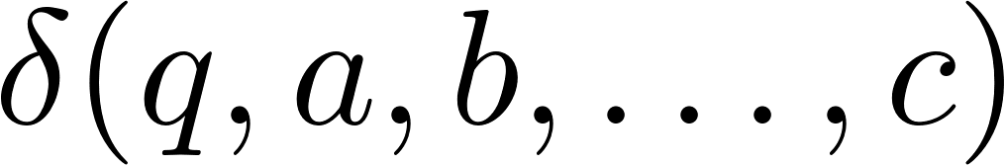



Definition of (Deterministic) Turing Machine (TM)

Slide 3

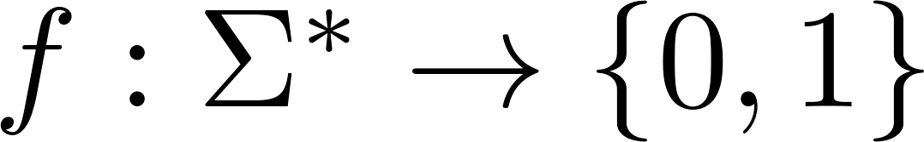
Definition of (Deterministic) Turing Machine (TM)
Usually the input string is at the beginning of the 1st tape
Other entries are blank
Special symbols “beginning” “blank” in tape alphabet
Can be viewed as computing a Boolean function
Input x

Slide 4
The Computation

Slide 5
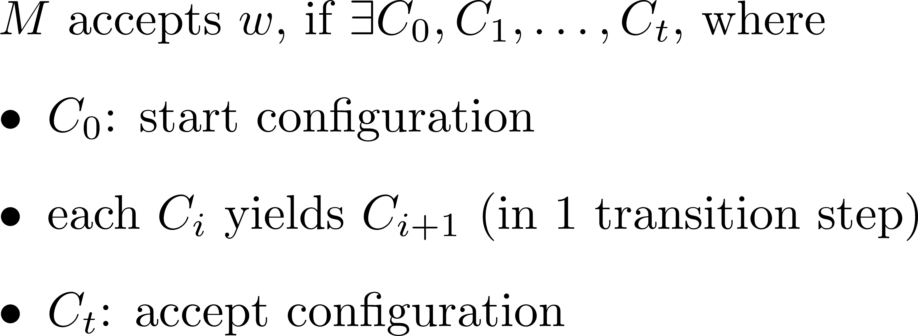
The Computation

Slide 6
TM vs Automata
TM’s storage equipment, tapes
Read-write heads, its moves and read-write operations
Tape is infinite
Halting states take effect immediately

Slide 7
Recognizable vs Decidable

Slide 8
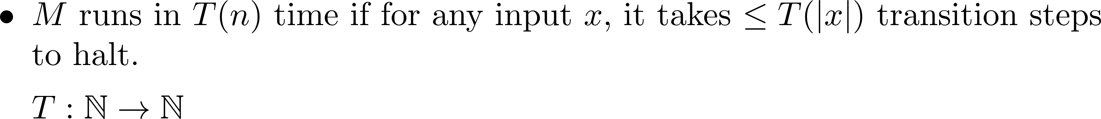
Function Computing Definition and Computation time

Slide 9
Example

Slide 10
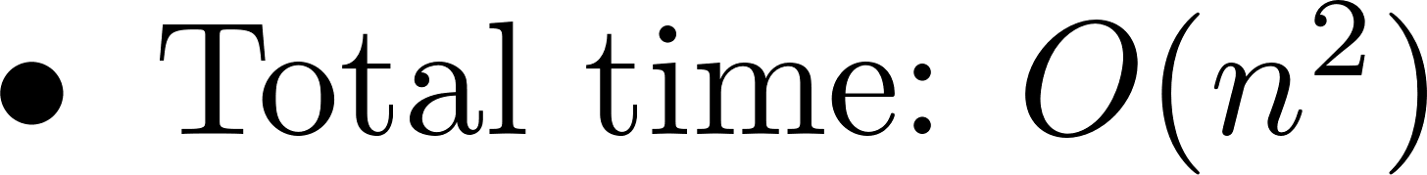
Running Time

Slide 11
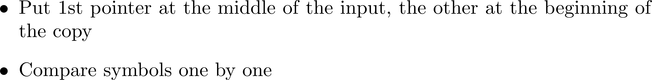


Example

Slide 12
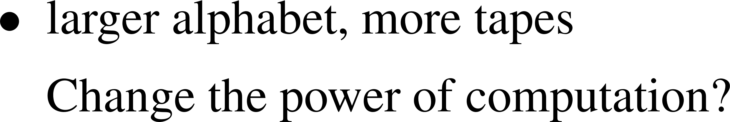
Variants of TM

Slide 13

Large alphabet (but still constant sizes)

Slide 14
Multiple Tapes
k-tapes vs 1 tape
Any advantage? Or can we do simulation?

Slide 15
Multiple Tapes

Slide 16

Multiple Tapes
Sequential
Parallel

Slide 17
Church Turing Thesis
Other variants: bidirectional tapes, oblivious TMs, but turned out to be roughly equivalent in power
In fact, there are many other proposed computational models of computation, and they all turn out to be equivalent to TMs
Church-Turing Thesis:
Intuitive notion of algorithms are equivalent to TM computations
No physically realizable algorithms are found to be not realizable by TMs yet.

Slide 18
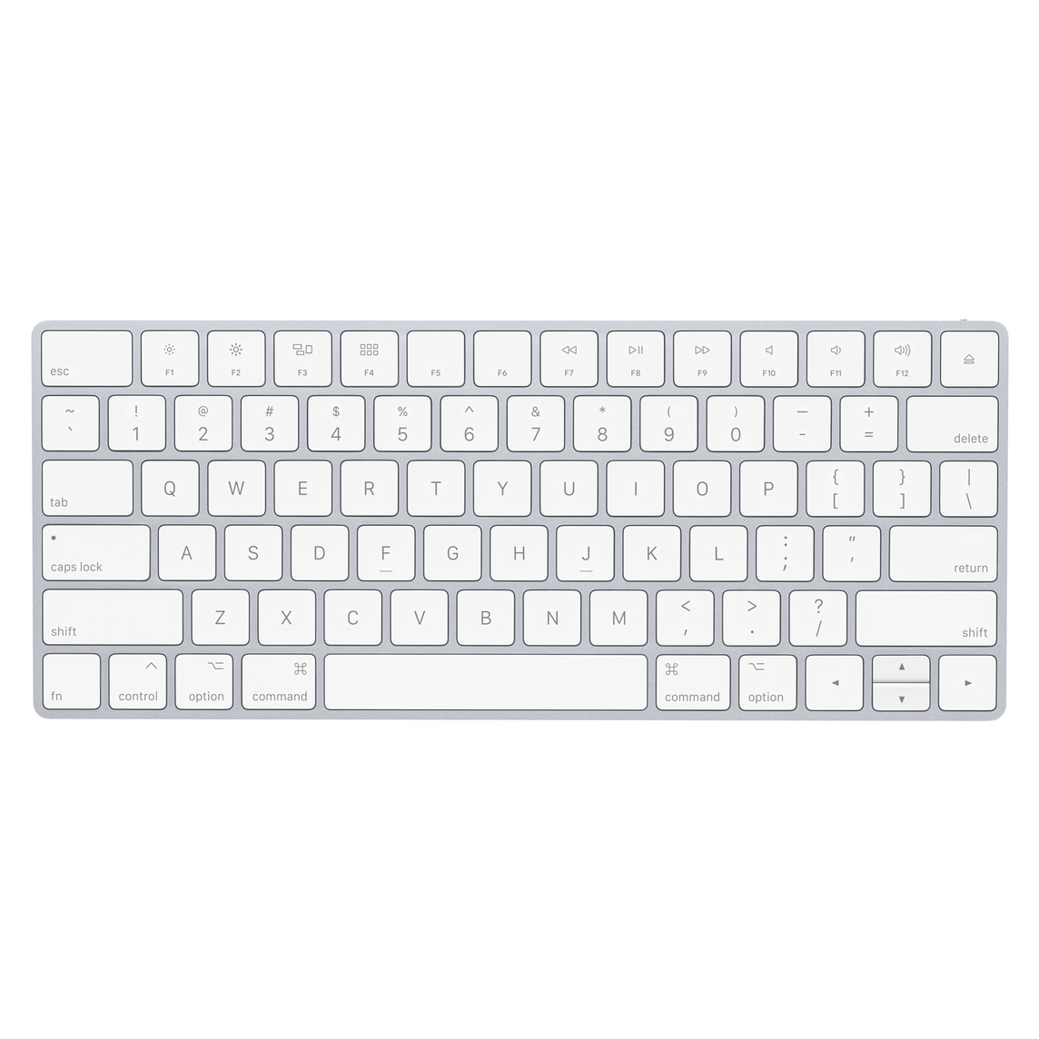
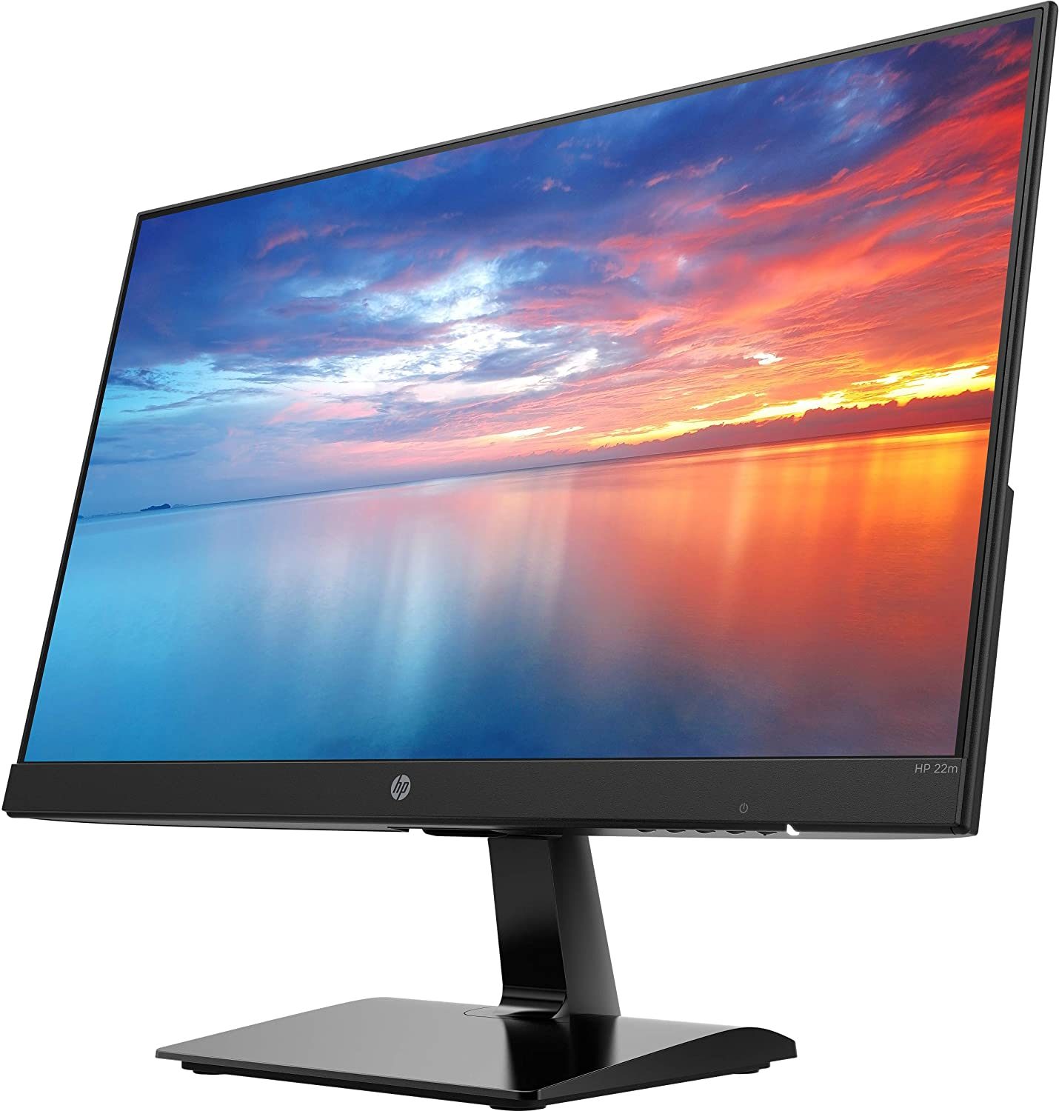

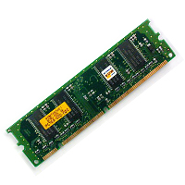

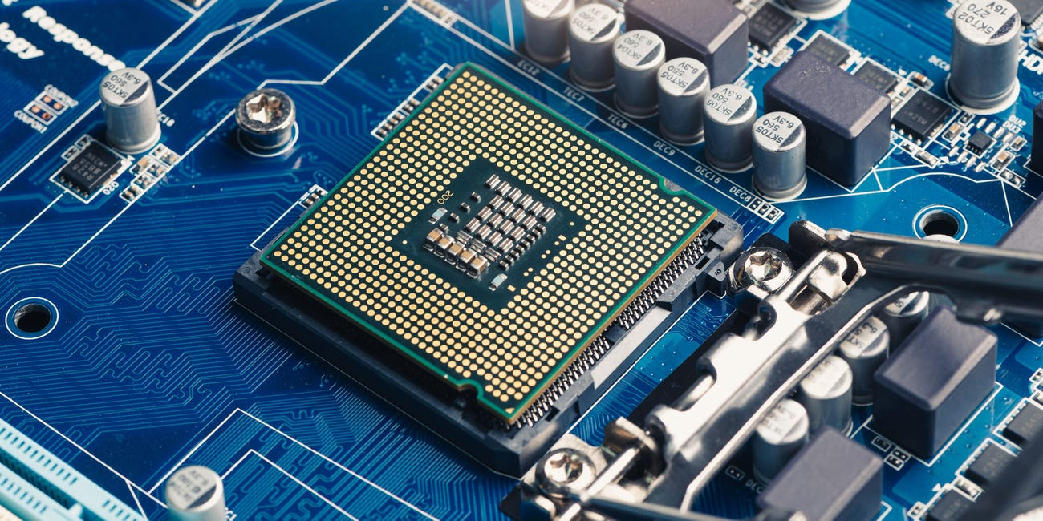

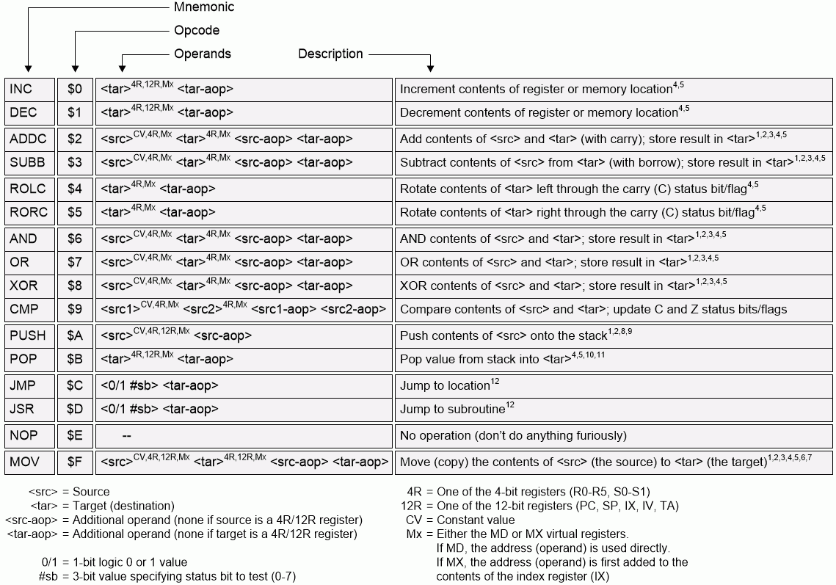

Computer vs TM

Slide 19
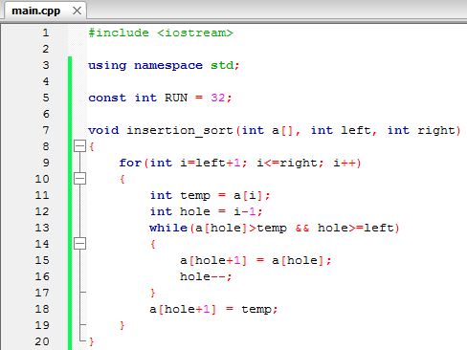



TM vs algorithms

Slide 20
Universal TM
A modern computer is quite general and can run different algorithms (apps)
How about TMs? A TM which can run other TMs?
Universal TM.

Slide 21
Universal TM
A TM can also be represented by a (binary) string.
Thus a TM can also be used as an input/data to another TM.
This blurs the distinction between software, hardware and data.
Brings up the idea of a universal TM (first observed by Turing himself)

Slide 22

Universal TMs
There exists one universal TM that can simulate any other TM.

Slide 23
Universal TMs

Slide 24


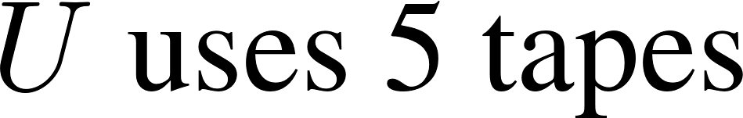

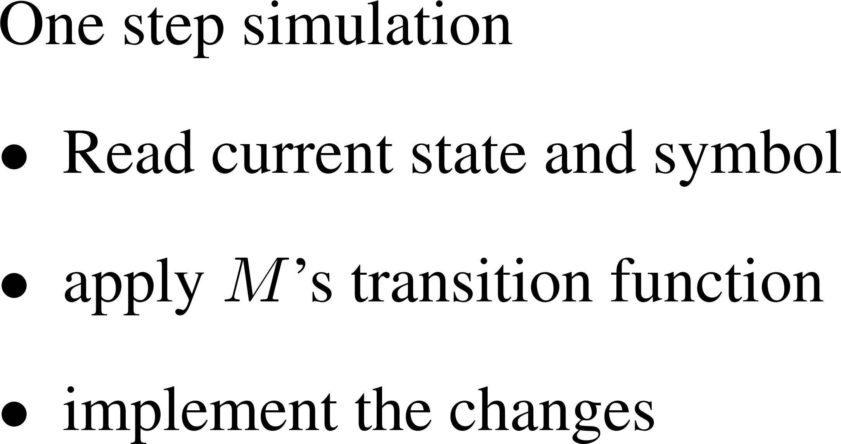

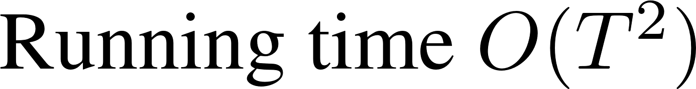
Universal TMs

